Slide 1


Binary Search Session No.: 10 Course Name: Design and Analysis of Algorithm Course Code: R1UC407B Duration: 50 minutes Date of Conduction of Class:

Slide 2

Review of the key concepts 1. Divide and Conquer approach 2. Analyzing Recursive Algorithms

Slide 3
Let’s play Guessing the number game :
How it works:
Think of a number between 1 and 100 in your mind, (say 42 - don’t reveal-keep in mind )
Ask students to guess it.
Discuss how they can optimize their guessing strategy

Slide 4
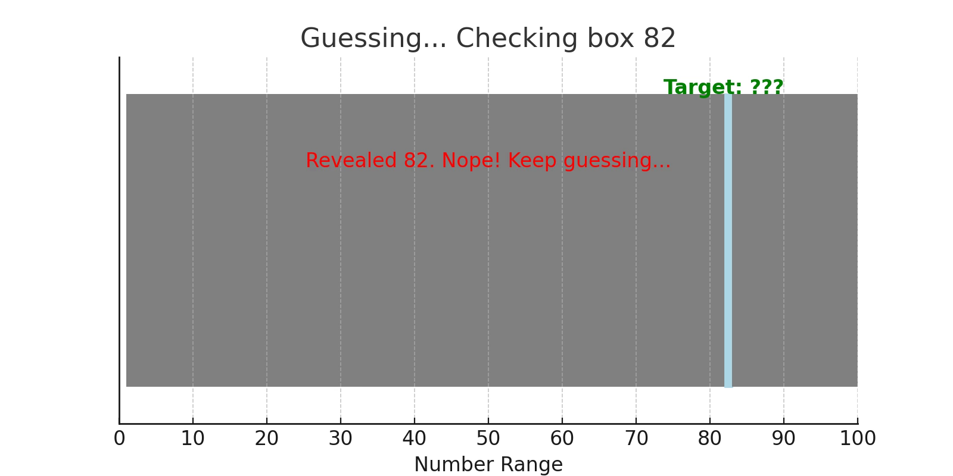
Case 1: When no Strategy is used at all

Slide 5
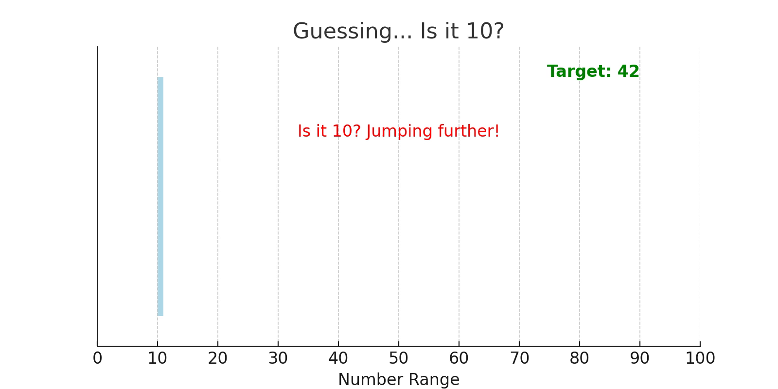
Case 2: Some Strategy, but not efficient

Slide 6
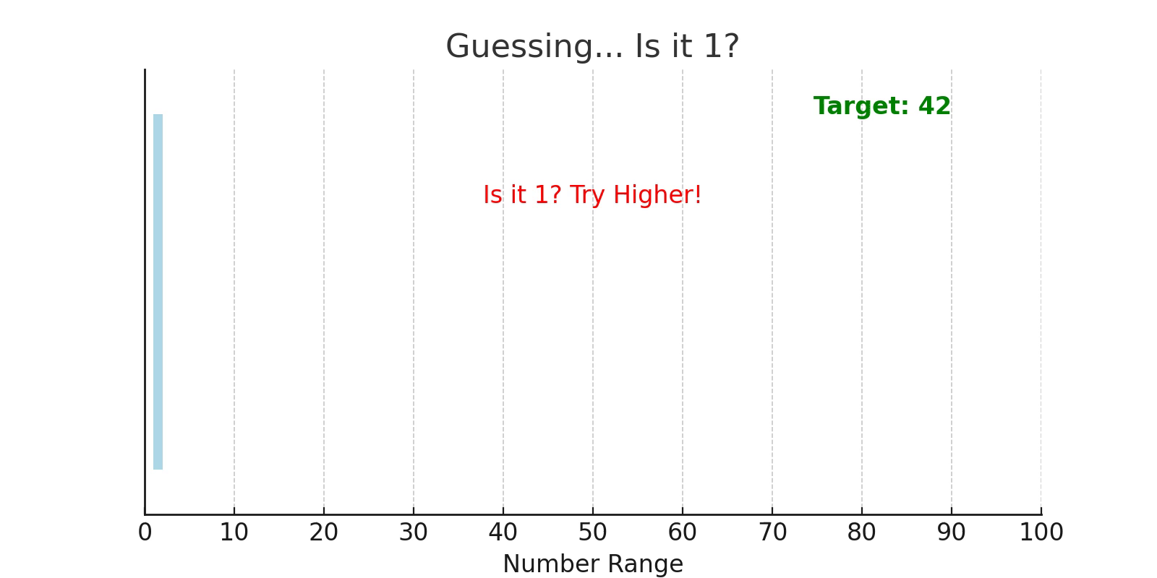
Case 3: Another Strategy, inefficeint

Slide 7
Reflection - Opening Activity
Out of all 3 shown Strategies, no one is efficent.
What is the main disadvantage of linear search?

Slide 8
At the end of this session students will be able to
Learning Outcome 1: Apply Binary search on given sorted list of elements.
Learning Outcome 2: Implement binary search in a programming language (e.g., Python, Java, or C++).

Slide 9
Session Outline
Introduction to Binary Search
How Binary Search Works
Time Complexity Analysis
Implementation of Binary Search
Practice Problems

Slide 10
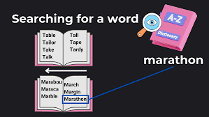
How would you find a specific word in a dictionary quickly?

Slide 11
Concept and Definition for Learning Activity 1
Binary Search: A search algorithm that finds the position of a target value within a sorted array by repeatedly dividing the search interval in half.

Slide 12
Learning Activity 1(a) -"Guess the Number" Game
Activity: Students will play a game where they guess a number between 1 and 100, say 42, with the teacher responding "higher" or "lower" after each guess.
Purpose: To demonstrate how binary search works by narrowing down the search range.
Skills Encouraged:
Cognitive skills (strategic thinking).
Analytical skills (understanding the process of elimination).

Slide 13
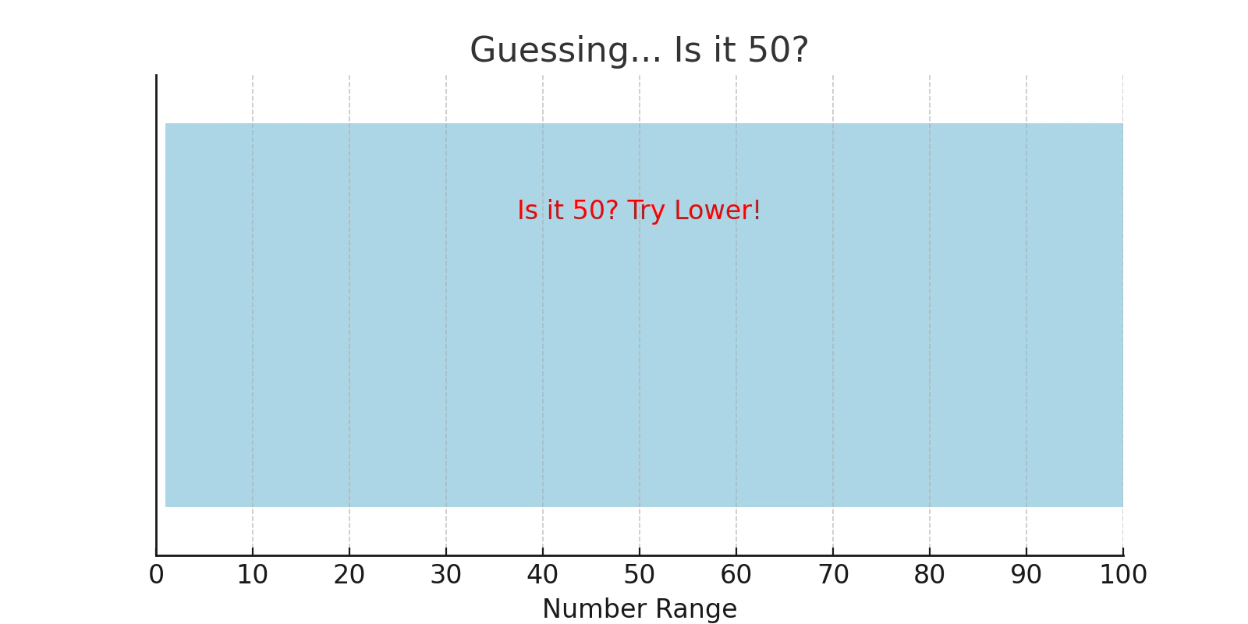
After each guess, say "Too high" or "Too low" until they find the number.

Slide 14
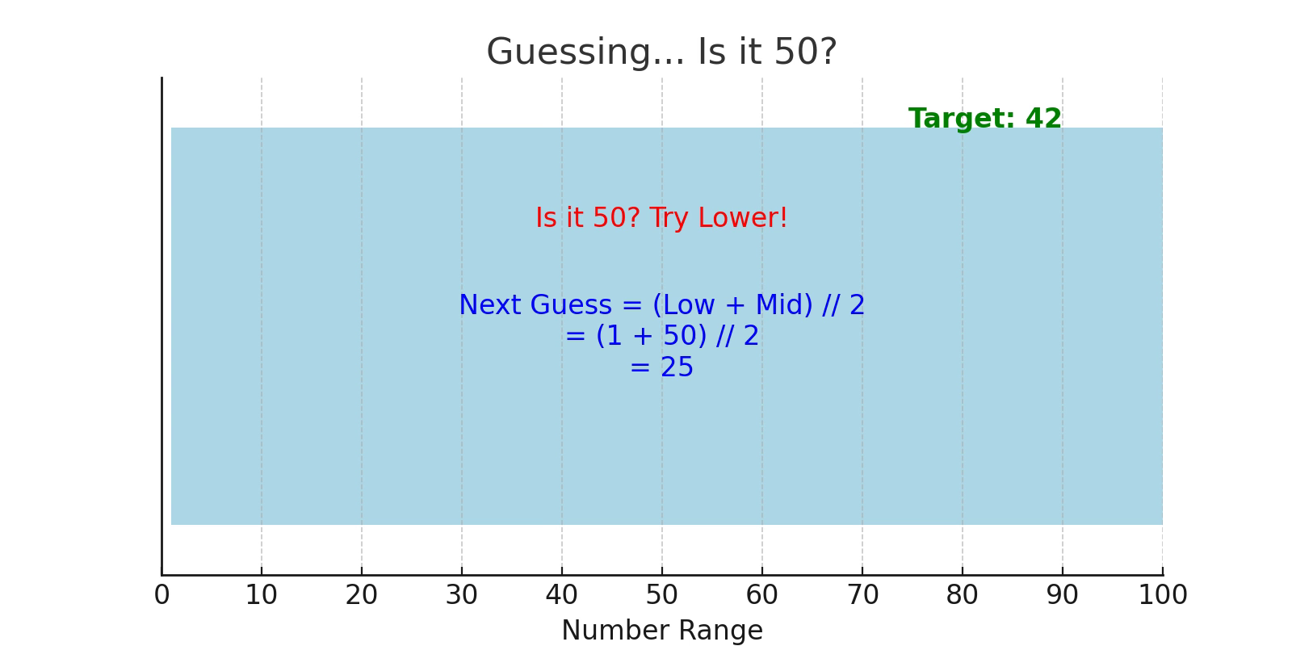

Slide 15
Some Questions ..?
Why is sorting important for binary search?
Can you think of a real-life example where binary search might be useful?

Slide 16
Reflection- Learning Activity 1(a)
Discussed the strategy which students used to guess the number.
Relate the activity to binary search.

Slide 17
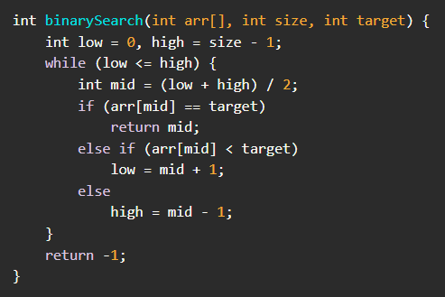
Working of Binary search

Slide 18
Learning Activity 1(b) - Think Pair Share [15 min]
Apply Binary Search on the following list of numbers -
3,6,8,12,14,17,25,29,31,36,42,47,53,55,62
(1) Search 42
(2) Search 12
(3) Search 30
Also find number of comparisons required in each case.
Ask students to solve it on their notebook and after scanning ask them to upload on pedlet.

Slide 19
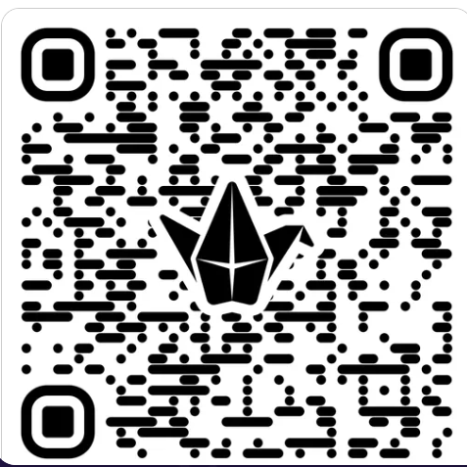

Activity Time Padlet QR codes to Submit the response
Section 1 QR
Section 2 QR

Slide 20
Reflection- Learning Activity 1(b)
Discussed the number of comparison required in each case. Also, cover 1 case , when element is not found in the list. Then students will get to know, how the algorithm successfully stops.

Slide 21
Concept and Definition for Learning Activity 2
Binary search has a time complexity of O(log n), making it much faster than linear search for large datasets.

Slide 22
index | 1 | 2 | 3 | 4 | 5 | 6 | 7 | 8 | 9 | 10 | 11 | 12 | 13 | 14 | 15
value | 3 | 6 | 8 | 12 | 14 | 17 | 25 | 29 | 31 | 36 | 42 | 47 | 53 | 55 | 62
8
4
12
2
10
14
6
1
3
5
7
9
11
13
15

Slide 23
Learning Activity 2 [15 min]
Activity: Write a program to implement binary search in a programming language (e.g., C or java).
Purpose: To reinforce the concept through hands-on coding practice.
Skills Encouraged:
Cognitive skills (problem-solving).
Analytical skills (debugging and testing).

Slide 24
Reflection-Learning Activity 2
Discuss the challenges which students faced while implementing binary search.
Highlight the importance of sorted data for binary search to work.
Analyze the complexity of Binary Search.

Slide 25
Summary
Binary search is an efficient algorithm for finding an item in a sorted list.
It works by repeatedly dividing the search range in half.
Time complexity: O(log n).

Slide 26
Post session activities
Implement recursive version of Binary search.

Slide 27
Information about the next lesson
Divide and Conquer: Strassen's Matrix Multiplication

Slide 28
Thank you

